Slide 1
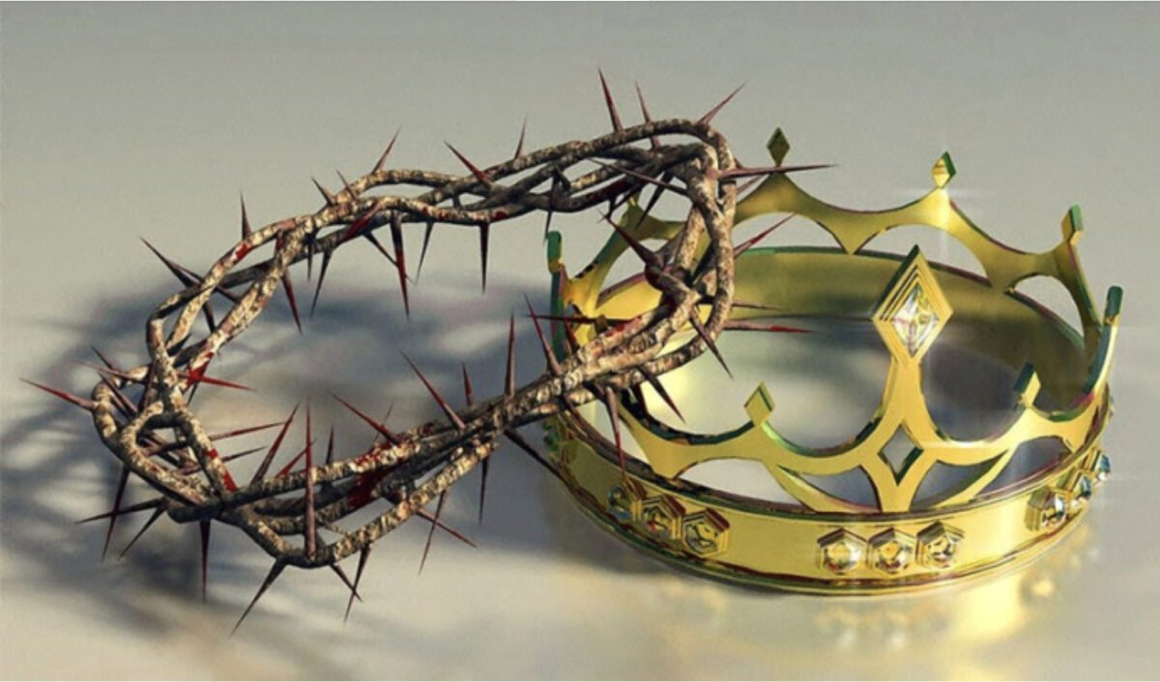
Christ the King

Slide 2
We stand to sing
Gathering Hymn 497
Let All the World
In Every Corner Sing

Slide 3
Let all the world in every corner sing,
my God and King.
The heavens are not too high,
his praise may thither fly:
the earth is not too low,
his praises there may grow.
Let all the world in every corner sing,
my God and King.

Slide 4
Let all the world in every corner sing,
my God and King.
The church with psalms must shout,
no door can keep them out;
but above all the heart
must bear the longest part.
Let all the world in every corner sing,
my God and King.

Slide 5
Gathering
In the name of the Father,
and of the Son,
and of the Holy Spirit.
All Amen.

Slide 6
Words of Welcome
Grace, mercy and peace
from God our Father
and the Lord Jesus Christ
be with you
All and also with you.

Slide 7
Prayers of Penitence
God the Father forgives us in Christ and heals us by the Holy Spirit.
Let us therefore put away all anger and bitterness, all slander and malice,
and confess our sins
to God our redeemer.

Slide 8
All Most merciful God,
Father of our Lord Jesus Christ,
we confess that we have sinned
in thought, word and deed.
We have not loved you with our whole heart.
We have not loved our neighbours as ourselves.

Slide 9
In your mercy
forgive what we have been,
help us to amend what we are,
and direct what we shall be;
that we may do justly,
love mercy,
and walk humbly with you, our God.
Amen.

Slide 10
Lord, have mercy.
All Lord, have mercy.
Christ, have mercy.
All Christ, have mercy.
Lord, have mercy.
All Lord, have mercy.

Slide 11
Absolution
Almighty God, who forgives all who truly repent,
have mercy upon you,
pardon and deliver you from all your sins,
confirm and strengthen you in all goodness,
and keep you in life eternal;
through Jesus Christ our Lord.
All Amen.

Slide 12
Gloria (Raemoir version)
We sing together
All Glory to God in the highest,
and peace to his people on earth.
Lord God, heavenly King,

Slide 13
almighty God and Father,
we worship you, we give you thanks,
we praise you for your glory.
(music break)
Lord Jesus Christ, only Son of the Father,
Lord God, Lamb of God,

Slide 14
you take away the sin of the world,
have mer—cy on us;
you are seated at the right hand of the Fa—ther
receive our prayer.
(music break)

Slide 15
For you alone are the Ho—ly One,
you alone are the Lord,
you alone are the Most High,
Je—sus Christ,
with the Ho—ly Spirit,

Slide 16

in the glory of God the Fa—ther.
A—men, A—men.
Let us pray

Slide 17
Collect Prayer
God the Father,
help us to hear the call of Christ the King
and to follow in his service,
whose kingdom has no end;
for he reigns with you and the Holy Spirit, one God, one glory.
All Amen.

Slide 18
The Liturgy of the Word
Old Testament – Jeremiah 23:1-6
“Woe to the shepherds who are destroying and scattering the sheep of my pasture!” declares the Lord. This is what the Lord, the God of Israel, says to the shepherds who tend my people:

Slide 19
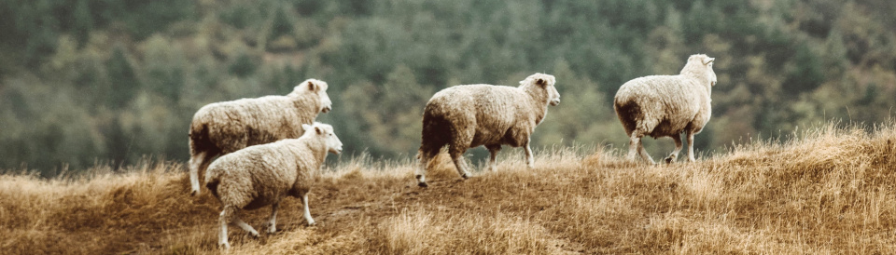
“Because you have scattered my flock and driven them away and have not bestowed care on them, I will bestow punishment on you for the evil you have done,” declares the Lord.

Slide 20
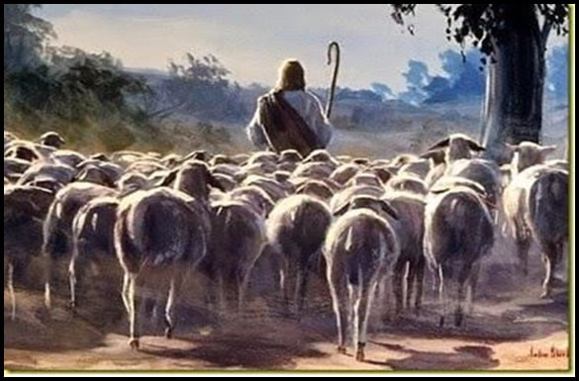
“I myself will gather the remnant of my flock out of all the countries where I have driven them and will bring them back to their pasture, where they will be fruitful and increase in number. I will place shepherds over them who will tend them, and they will no longer be afraid or terrified, nor will any be missing,” declares the Lord.

Slide 21
“The days are coming,” declares the Lord, “when I will raise up for David a righteous branch, a King who will reign wisely and do what is just and right in the land. In his days Judah will be saved and Israel will live in safety. This is the name by which he will be called: The Lord Our Righteous Saviour.
This is the word of the Lord.
All: Thanks be to God

Slide 22
Psalm 46
God is our refuge and strength, a well-proven help in trouble. Therefore we will not fear,
though the earth be removed, and though the mountains be carried
into the midst of the sea; though its waters roar and foam, though the mountains shake with its swelling.

Slide 23
There is a river
whose streams make glad the city of God, the dwelling place of the Most High.
God is in the midst of her; she will not be moved; God will help her in the early dawn.
He uttered His voice; the earth melted.
The Lord of Hosts is with us; the God of Jacob is our refuge.

Slide 24
Come, see the works of the Lord, who makes desolations in the earth. He makes wars cease to the end of the earth; He breaks the bow and cuts off the spear; He burns the chariot in the fire. Be still and know that I am God; I will be exalted among the nations,
I will be exalted in the earth.
The Lord of Hosts is with us; the God of Jacob is our refuge.

Slide 25
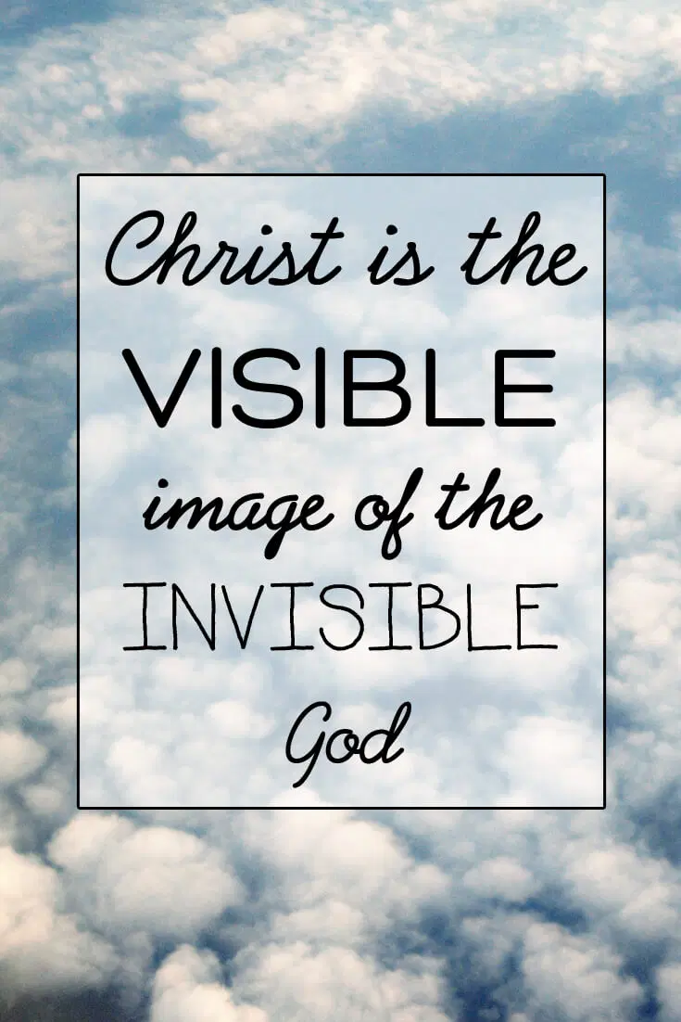
New Testament
Colossians 1:15-23

Slide 26


Slide 27
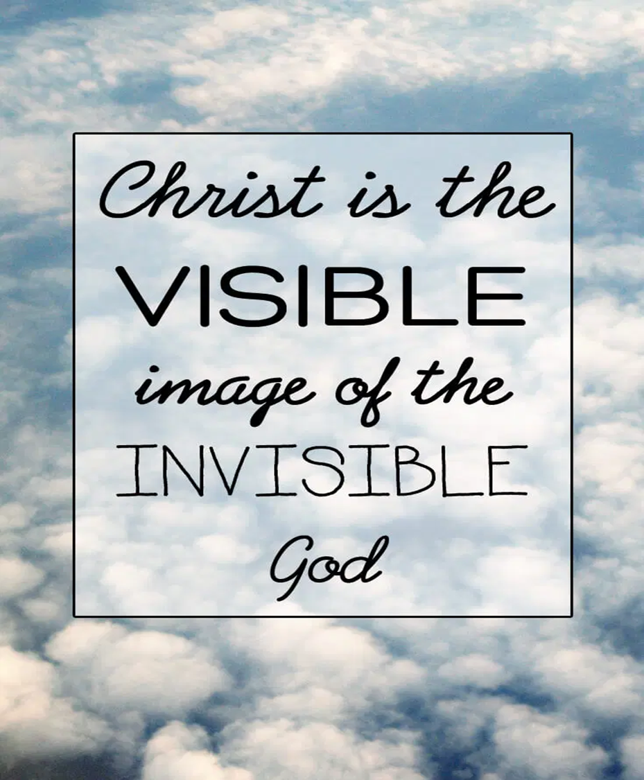
This is the word
of the Lord
All: Thanks be
to God

Slide 28
We stand to hear the Gospel
Gospel - We stand to hear the Gospel
Glory to the Father, and to the Son,
and to the Holy Spirit,
one God, who was, and who is,
and who is to come, the Almighty.
All: Alleluia, Alleluia, Alleluia x2

Slide 29
Gospel Greeting
Hear the Gospel of our Lord
according to Luke 23:33-43
All: Glory to you, O Lord. +

Slide 30
When they came to the place called the Skull, they crucified him there, along with the criminals – one on his right, the other on his left.
Jesus said, ‘Father, forgive them, for they do not know what they are doing.’ And they divided up his clothes by casting lots. The people stood watching, and the rulers even sneered at him.

Slide 31
They said, ‘He saved others; let him save himself if he is God’s Messiah, the Chosen One.’
The soldiers also came up and mocked him. They offered him wine vinegar and said, ‘If you are the king of the Jews, save yourself.’
There was a written notice above him, which read:
this is the king of the jews.

Slide 32
One of the criminals who hung there hurled insults at him: ‘Aren’t you the Messiah? Save yourself and us!’
But the other criminal rebuked him.
‘Don’t you fear God,’ he said, ‘since you are under the same sentence? We are punished justly, for we are getting what our deeds deserve.
But this man has done nothing wrong.’

Slide 33
Then he said, ‘Jesus, remember me when you come into your kingdom.’
Jesus answered him, ‘Truly I tell you, today you will be with me in paradise.’
This is the Gospel of the Lord
All: Praise to you O Christ

Slide 34
Sermon

Slide 35
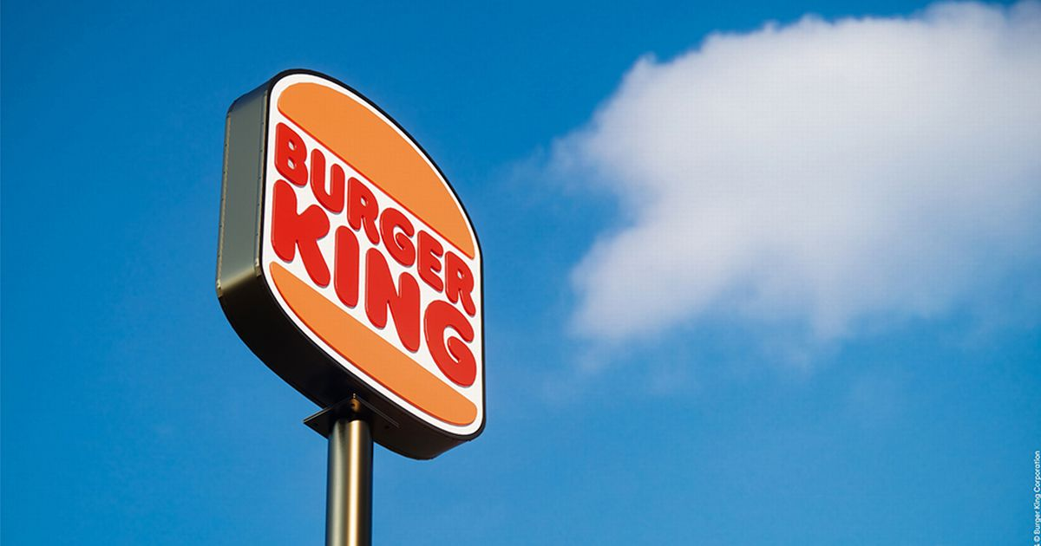
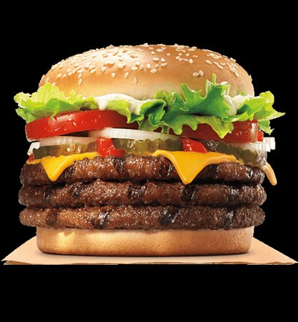

Slide 36

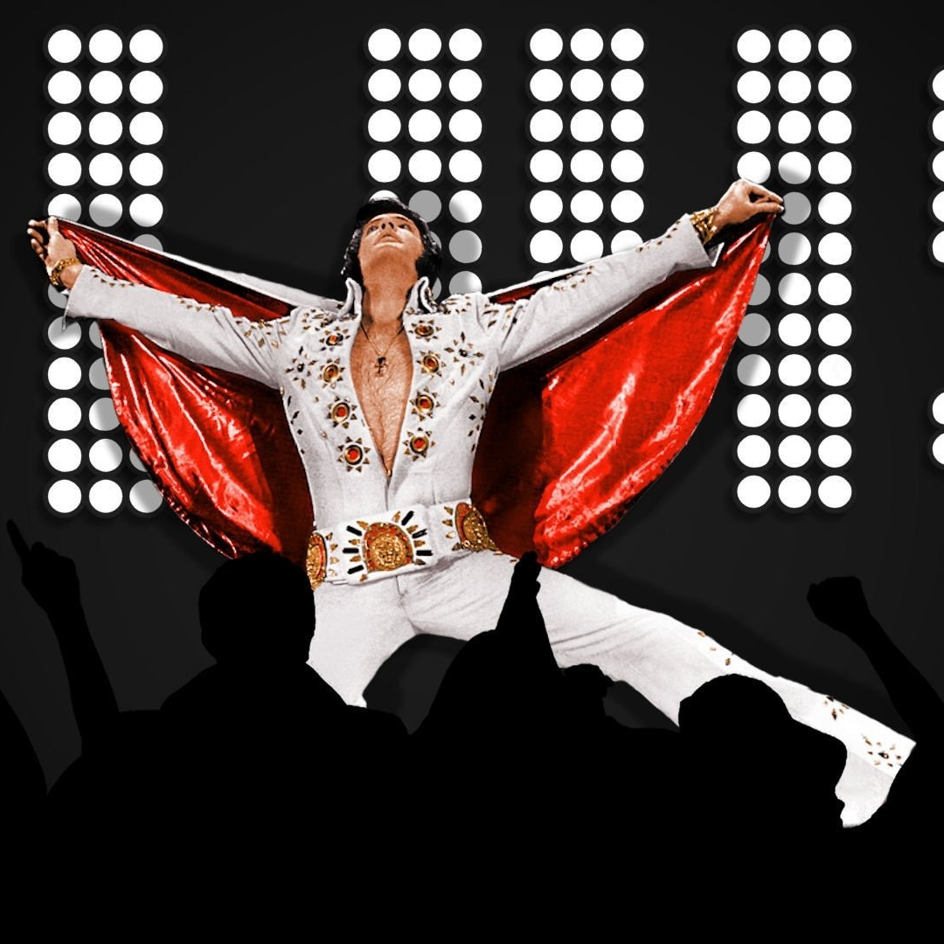

Slide 37



Slide 38

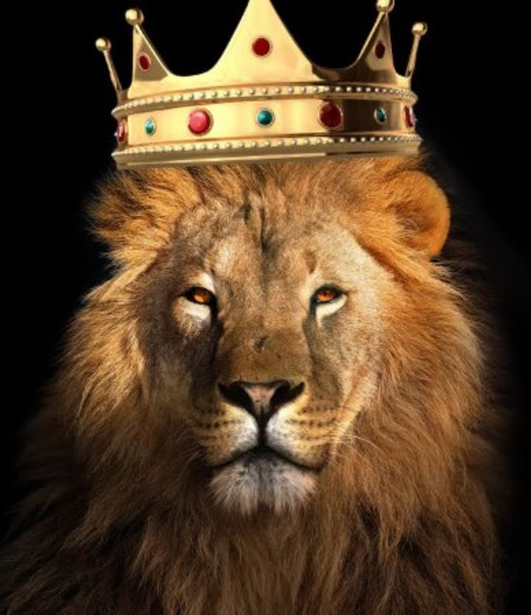
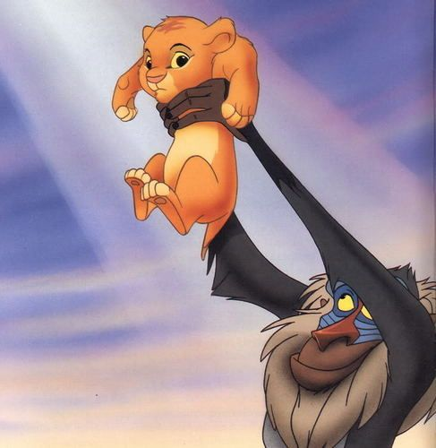


Slide 39
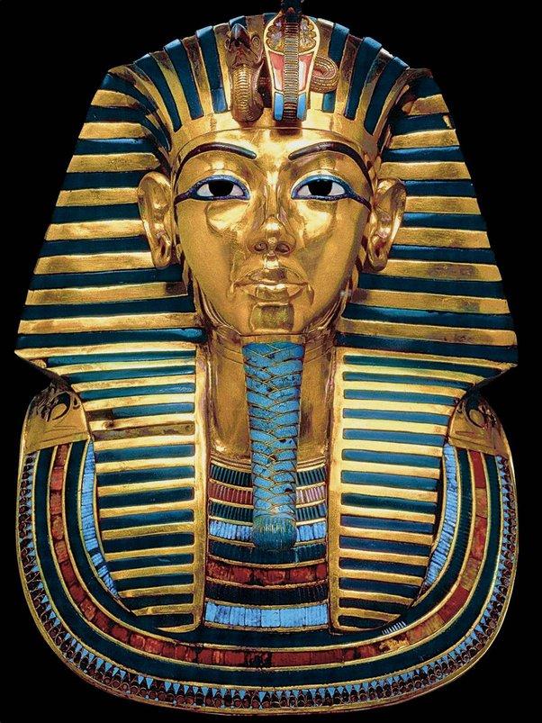
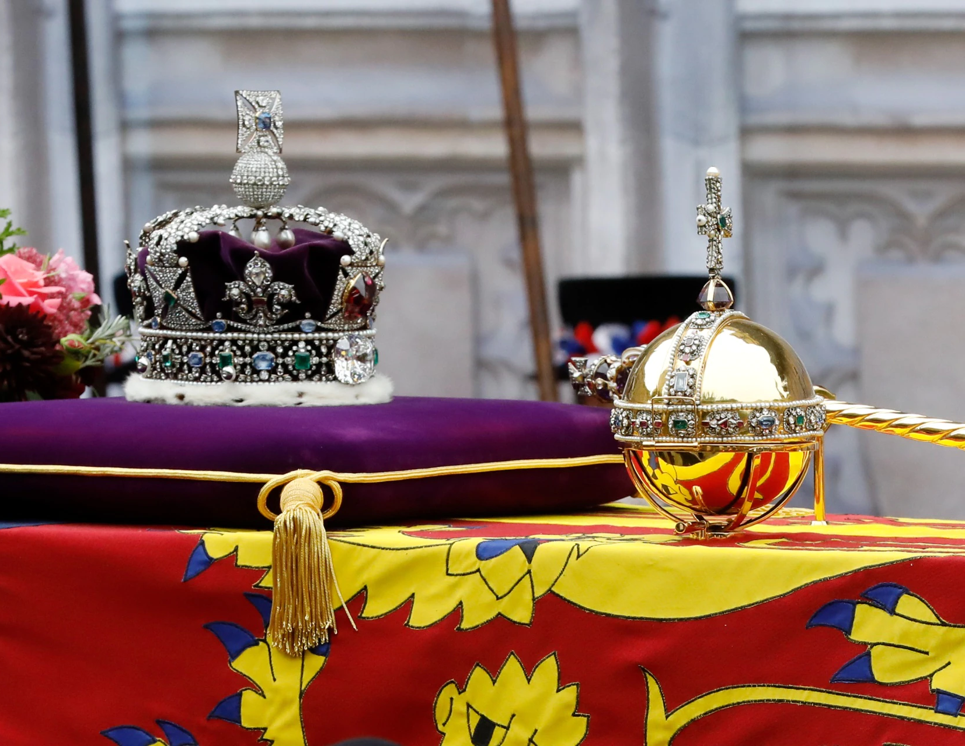

Slide 40
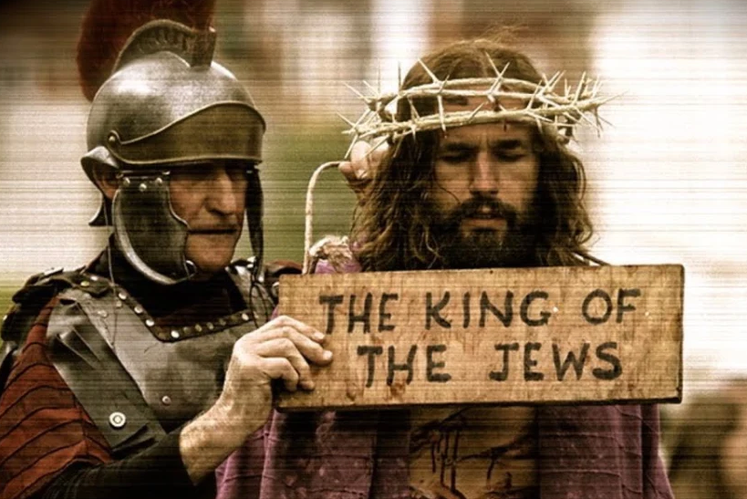
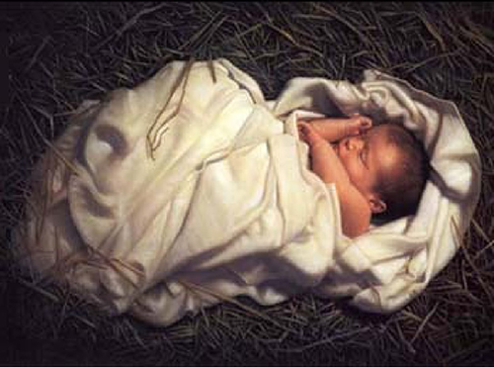

Slide 41


Slide 42
Creed
We stand to affirm our Faith
All We believe in one God,
the Father, the Almighty,
maker of heaven and earth,
of all that is,
seen and unseen.

Slide 43
We believe in one Lord, Jesus Christ,
the only Son of God,
eternally begotten of the Father,
God from God, Light from Light,
true God from true God,
begotten, not made,
of one Being with the Father;
through him all things were made.

Slide 44
For us and for our salvation
he came down from heaven,
was incarnate from the Holy Spirit and the Virgin Mary and was made man.
For our sake he was crucified
under Pontius Pilate;
he suffered death and was buried.

Slide 45
On the third day he rose again
in accordance with the Scriptures;
he ascended into heaven
and is seated at the right hand of the Father.
He will come again in glory to judge the living and the dead,
and his kingdom will have no end.

Slide 46
We believe in the Holy Spirit,
the Lord, the giver of life,
who proceeds from the Father and the Son,
who with the Father and the Son
is worshipped and glorified,
who has spoken through the prophets.

Slide 47
We believe in one holy catholic
and apostolic Church.
We acknowledge one baptism for the forgiveness of sins.
We look for the resurrection of the dead,
and the life of the world to come.
Amen.

Slide 48
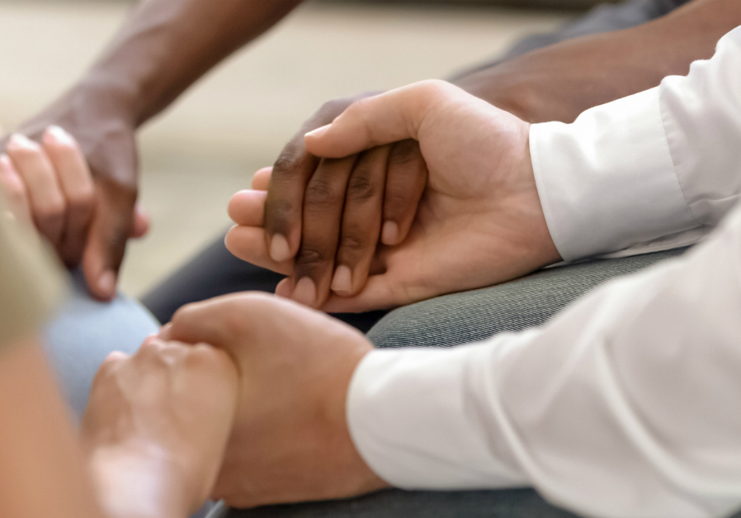
Prayers of
Intercession
And at the end
Merciful Father,
accept these prayers
for the sake of your Son,
our Saviour Jesus Christ.
Amen.

Slide 49
The Peace
Peace to you from God our heavenly Father.
Peace from his Son Jesus Christ who is our peace.
Peace from the Holy Spirit, the life-giver.
The peace of the triune God be always with you
All : and also with you.
Let us offer one another a sign of peace.

Slide 50
We stand to sing
Offertory Hymn 601
Thou Didst Leave Thy Throne

Slide 51
Thou didst leave thy throne
and thy kingly crown,
when thou camest to earth for me;
but in Bethlehem's home was there found
no room for thy holy nativity.
O come to my heart, Lord Jesus,
there is room in my heart for Thee.

Slide 52
Heaven's arches rang
when the angels sang,
proclaiming thy royal degree;
but of lowly birth didst thou come to earth, and in great humility.
O come to my heart, Lord Jesus,
there is room in my heart for Thee.

Slide 53
The foxes found rest,
and the bird had its nest
in the shade of the cedar tree;
but Thy couch was the sod,
O thou Son of God, in the desert of Galilee.
O come to my heart, Lord Jesus,
there is room in my heart for Thee.

Slide 54
Thou camest, O Lord, with the living word
that should set thy people free;
but with mocking scorn,
and with crown of thorn,
they bore thee to Calvary.
O come to my heart, Lord Jesus,
there is room in my heart for Thee.

Slide 55
When the heavens shall ring,
and the angels sing,
at Thy coming to victory,
let thy voice call me home,
saying "Yet there is room,
there is room at my side for thee."
O come to my heart, Lord Jesus,
there is room in my heart for Thee.

Slide 56
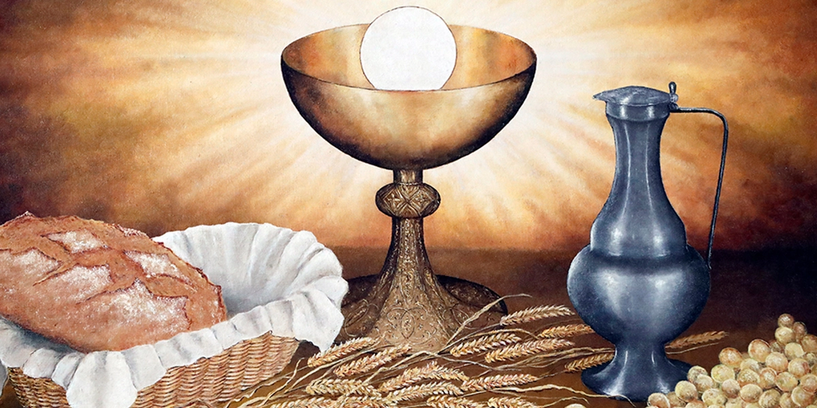
Eucharistic Prayer H
The Lord is here.
All His Spirit is with us.
Lift up your hearts.
All We lift them to the Lord.
Let us give thanks to the Lord our God.
All It is right to give thanks and praise.

Slide 57
It is right to praise you, Father, Lord of all creation;
in your love you made us for yourself.
When we turned away
you did not reject us,
but came to meet us in your Son.
All You embraced us as your children
and welcomed us to sit and eat with you.

Slide 58
In Christ you shared our life
that we might live in him and he in us.
All He opened his arms of love upon the cross
and made for all the perfect sacrifice for sin.
On the night he was betrayed,
at supper with his friends
he took bread, and gave you thanks;
he broke it and gave it to them, saying:

Slide 59
Take, eat; this is my body which is given for you;
do this in remembrance of me.
All Father, we do this in remembrance of him:
his body is the bread of life.
At the end of supper, taking the cup of wine,
he gave you thanks, and said:

Slide 60
Drink this, all of you; this is my blood of
the new covenant,
which is shed for you for the forgiveness of sins;
do this in remembrance of me.
All Father, we do this in remembrance of him:
his blood is shed for all.

Slide 61
As we proclaim his death and celebrate his
rising in glory,
send your Holy Spirit that this bread and this wine
may be to us the body and blood of your dear Son.
All As we eat and drink these holy gifts
make us one in Christ, our risen Lord.

Slide 62
With your whole Church
throughout the world
we offer you this sacrifice of praise
and lift our voice
to join the eternal song of heaven:

Slide 63
Sanctus (Holy holy) ()
We sing together
All Holy, holy, holy Lord, God of power and might, heaven and earth are full of your glory. Hosanna in the highest, highest, Hosanna in the highest.
Blessed is he who comes in the name of the Lord. Hosanna in the highest, highest.
Hosanna in the highest, the highest, the highest,
the highest.

Slide 64
The Lord’s Prayer
As our Saviour taught us, so we pray
All Our Father, who art in heaven, hallowed be thy name; thy kingdom come; thy will be done; on earth as it is in heaven. Give us this day our daily bread.

Slide 65
And forgive us our trespasses, as we forgive those who trespass against us.
And lead us not into temptation; but deliver us from evil. For thine is the kingdom, the power and the glory, for ever and ever. Amen.

Slide 66
Breaking of the Bread
The Minister breaks the consecrated bread.
We break this bread
to share in the body of Christ.
All Though we are many,
we are one body,
because we all share in one bread.

Slide 67
Lamb of God
All Lamb of God, you take away the sins of the world, have mercy on us.
Lamb of God, you take away the sin of the world, have mercy on us.
Lamb of God, you take away the sin of the world, grant us peace.
Congregation Kneels

Slide 68
Jesus is the Lamb of God
who takes away the sin of the world.
Blessed are those who are called to his supper.
All Lord, I am not worthy to receive you,
but only say the word,
and I shall be healed.

Slide 69
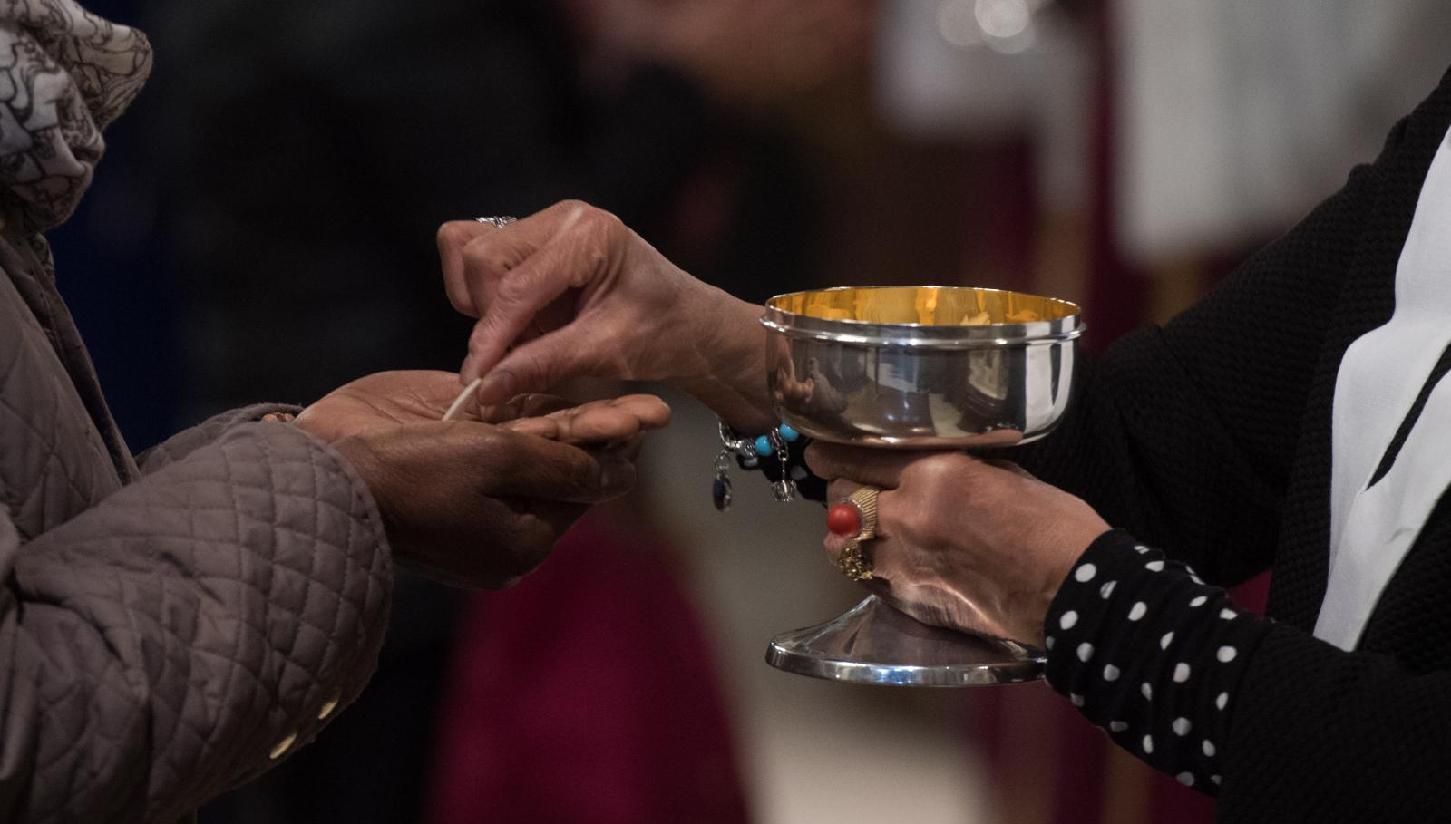
Distribution of Communion

Slide 70
We stand to sing
Communion Hymn 432
The Servant King

Slide 71
From heav'n you came, helpless babe,
entered our world, your glory veiled;
not to be served, but to serve
and give your life that we might live.
This is our God, the Servant King,
He calls us now to follow him,
to bring our lives as a daily offering
of worship to the Servant King.

Slide 72
. There in the garden of tears,
my heavy load He chose to bear;
His heart with sorrow was torn,
'Yet not my will, but yours' he said.
This is our God, the Servant King,
He calls us now to follow him,
to bring our lives as a daily offering of worship to the Servant King.

Slide 73
Come see his hands and his feet,
the scars that speak of sacrifice,
hands that flung stars into space
to cruel nails surrendered.
This is our God, the Servant King,
He calls us now to follow him,
to bring our lives as a daily offering of worship to the Servant King.

Slide 74
So let us learn how to serve,
and in our lives enthrone him;
each other’s needs to prefer,
for it is Christ we’re serving.
This is our God, the Servant King,
He calls us now to follow him,
to bring our lives as a daily offering of worship to the Servant King.

Slide 75
Prayer after Communion
All Almighty God, we thank you for feeding us
with the body and blood of your Son
Jesus Christ. Through him we offer you
our souls and bodies to be a living sacrifice.
Send us out in the power of your Spirit
to live and work to your praise and glory.
Amen.

Slide 76

God of Mission,
who alone brings growth
to your church, send your Holy Spirit
To give Vision to our planning,
Wisdom to our Actions,
and Power to our Witness.
Help our church to grow in numbers,
in Spiritual Commitment to You,
And in Service to our local Community.
Through Jesus Christ our Lord. Amen.
The prayer
for

Slide 77
Post Communion Collect
We praise and thank you, O Christ,
for this sacred feast:
for here we receive you,
here the memory of your passion is renewed,
here our minds are filled with grace,
and here a pledge of future glory is given,
when we shall feast at that table where you reign with all your saints for ever.
All: Amen

Slide 78



Slide 79
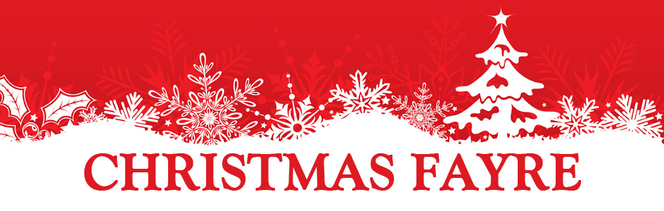



SATURDAY 3RD DECEMBER
Prizes & Donations wanted please!
Bottles/Cakes/Chocs

Slide 80
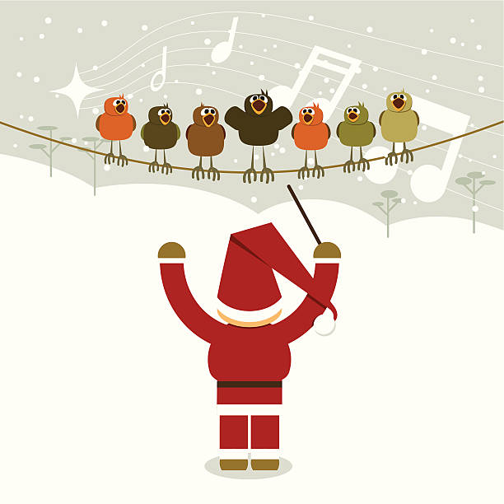


Christmas
Choir
Practice
Tuesdays
at 7pm

Slide 81

FAMILY FELLOWSHIP
Saturday 27th Nov
4.30pm

Slide 82
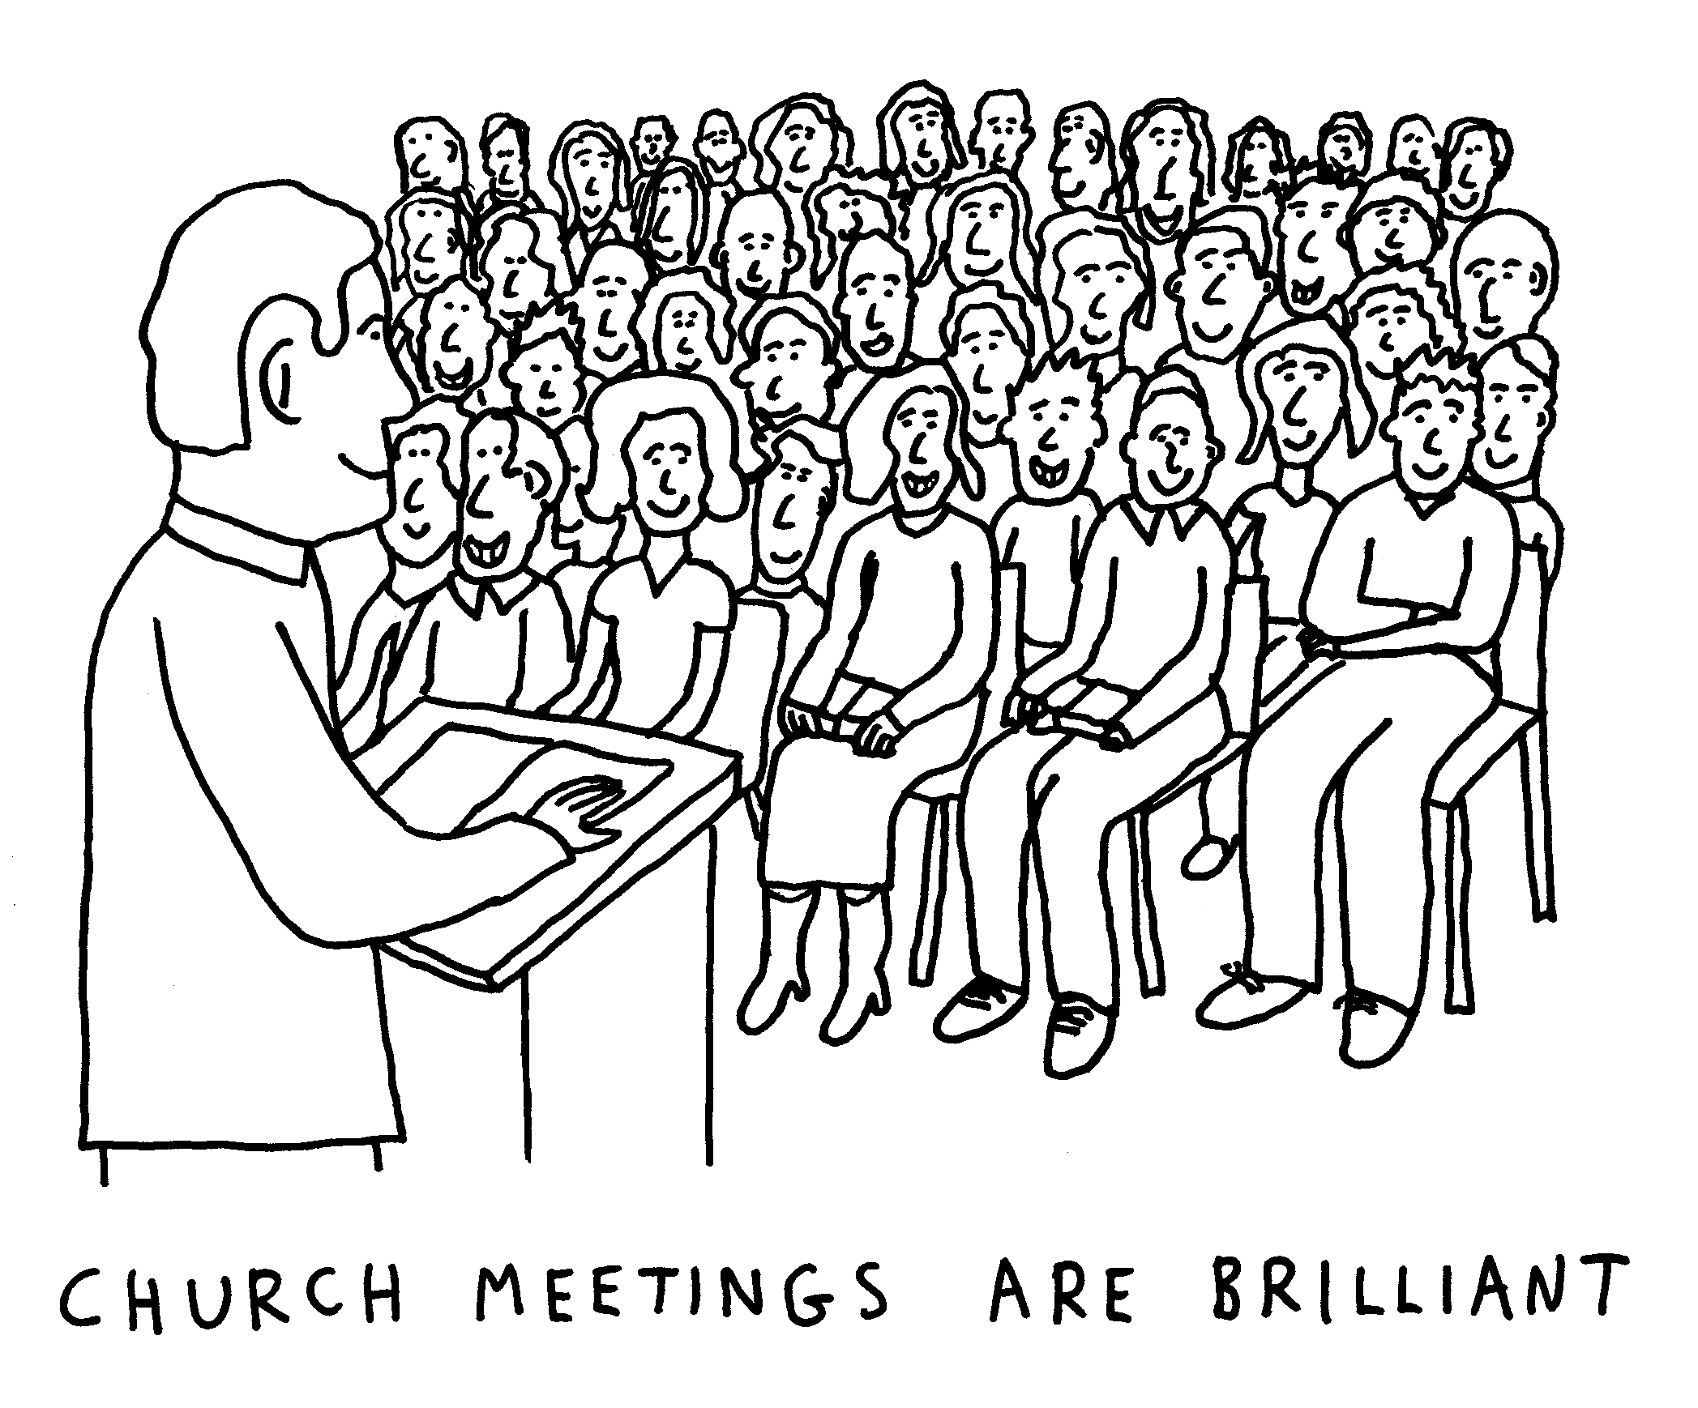
PCC
Next Week!
11.30 -after
the Service

Slide 83

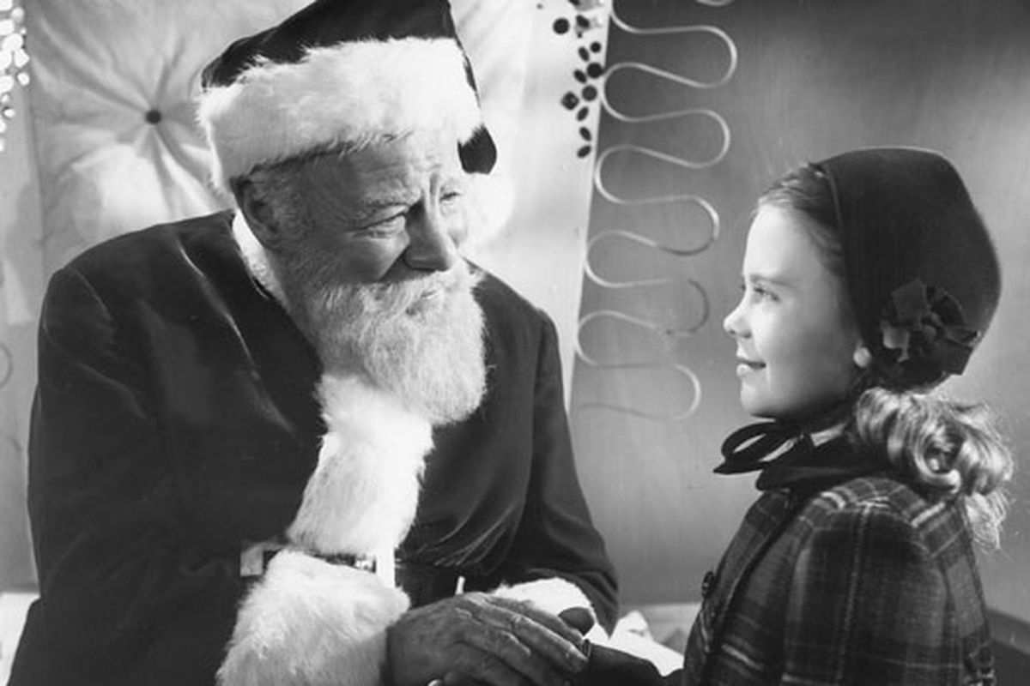
Someone to Believe in!
4 WEEK COURSE
Starts
30th November
St Anne’s Church Wed Evenings : 7.30-9pm

Slide 84
Final Blessing
May the love of the Father, the tenderness of the Son, and the presence of the Spirit, gladden your heart and bring peace to your soul, this day and every day!
All Amen.

Slide 85

The Dismissal
Minister dismisses the people
Go in peace to love
and serve the Lord
All In the name of
Christ. Amen.

Slide 86
Exit Hymn 563
Rejoice the Lord is King

Slide 87
Rejoice, the Lord is King,
your Lord and king adore;
mortals, give thanks and sing
and triumph ever more:
Lift up your heart, lift up your voice;
rejoice, again I say, rejoice.

Slide 88
Jesus the Saviour reigns,
the God of truth and love;
when he had purged our stains,
he took his seat above.
Lift up your heart, lift up your voice;
rejoice, again I say, rejoice.

Slide 89
His kingdom cannot fail;
he rules o'er earth and heaven:
the keys of death and hell
are to our Jesus given.
Lift up your heart, lift up your voice;
rejoice, again I say, rejoice.

Slide 90
He sits at God's right hand
till all his foes submit
and bow to his command
and fall beneath his feet.
Lift up your heart, lift up your voice;
rejoice, again I say, rejoice.

Slide 91


